Slide 1
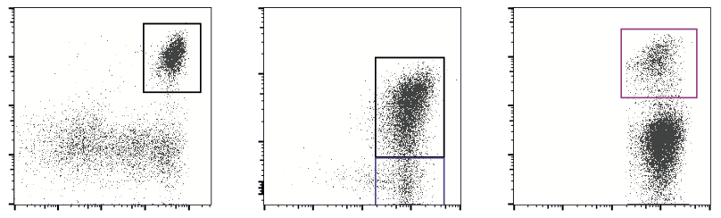
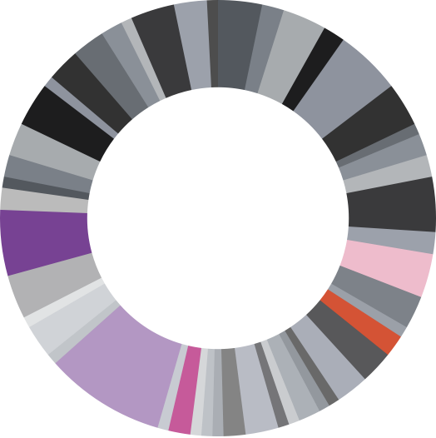
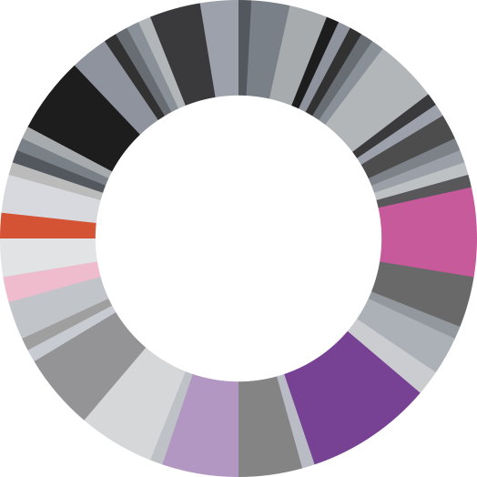
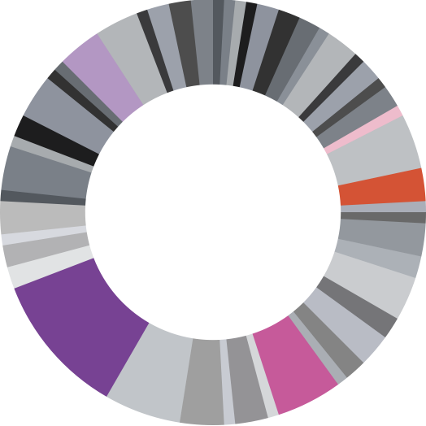
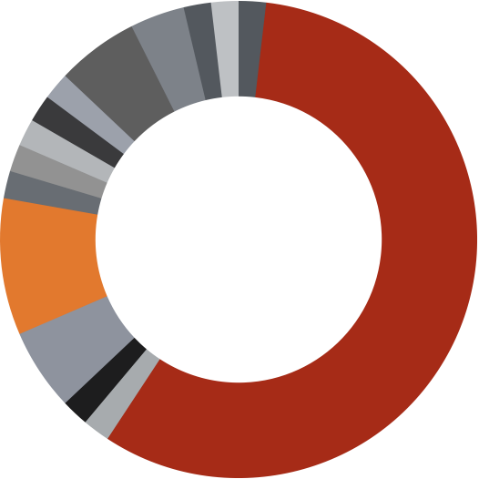

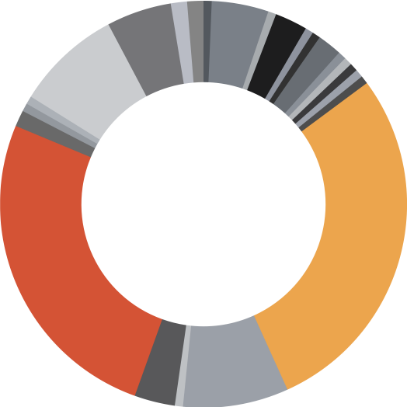
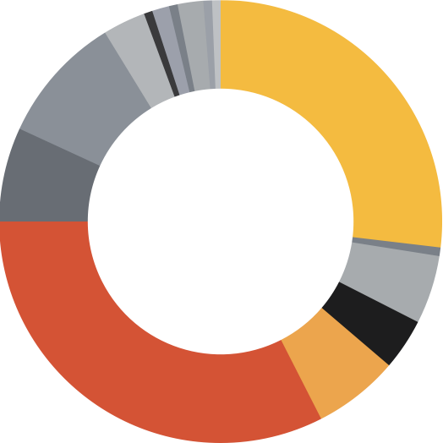
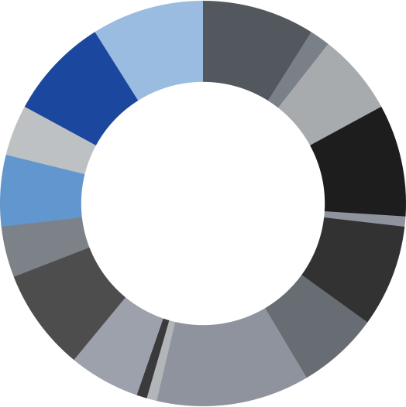
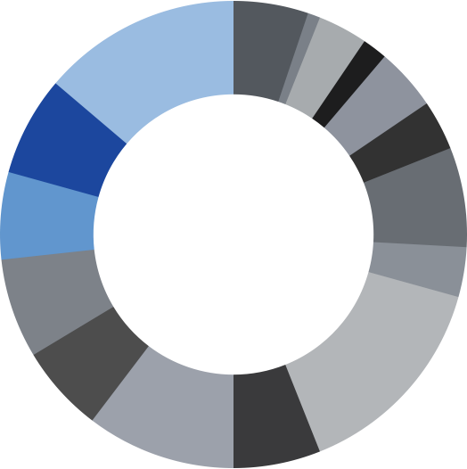
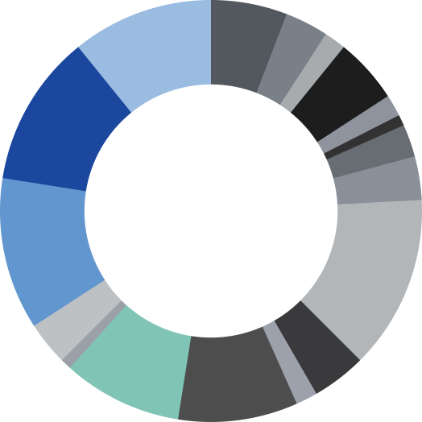
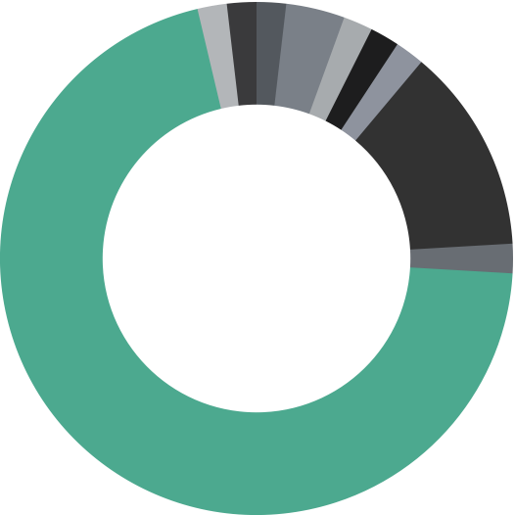
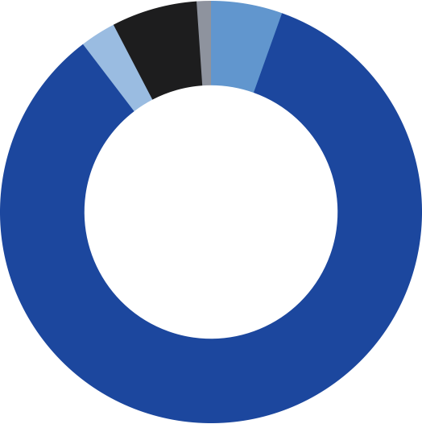
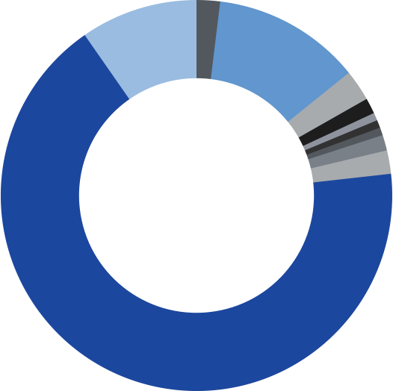
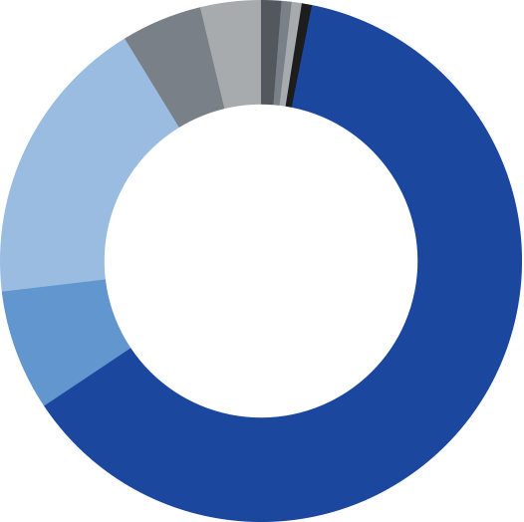
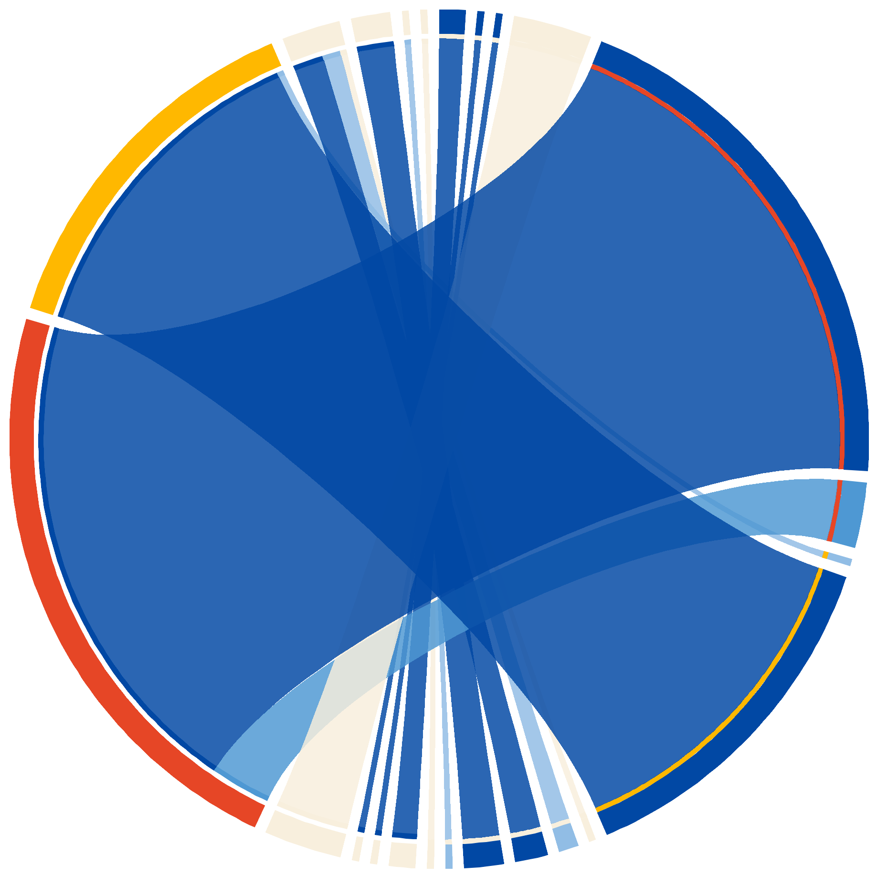
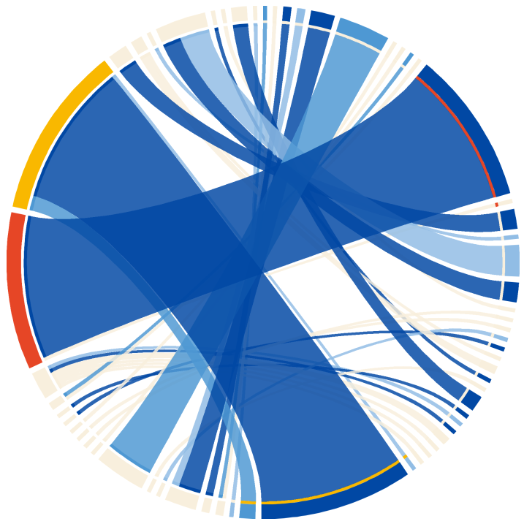



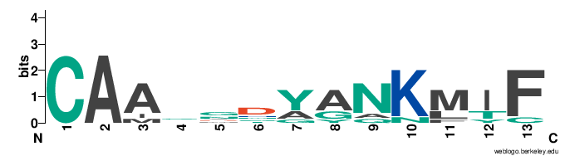

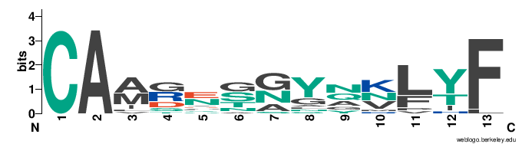
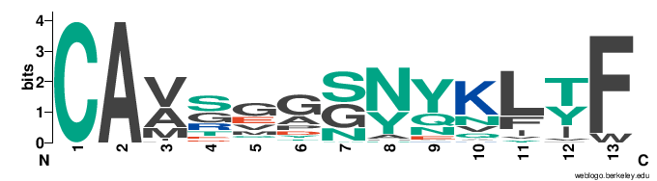






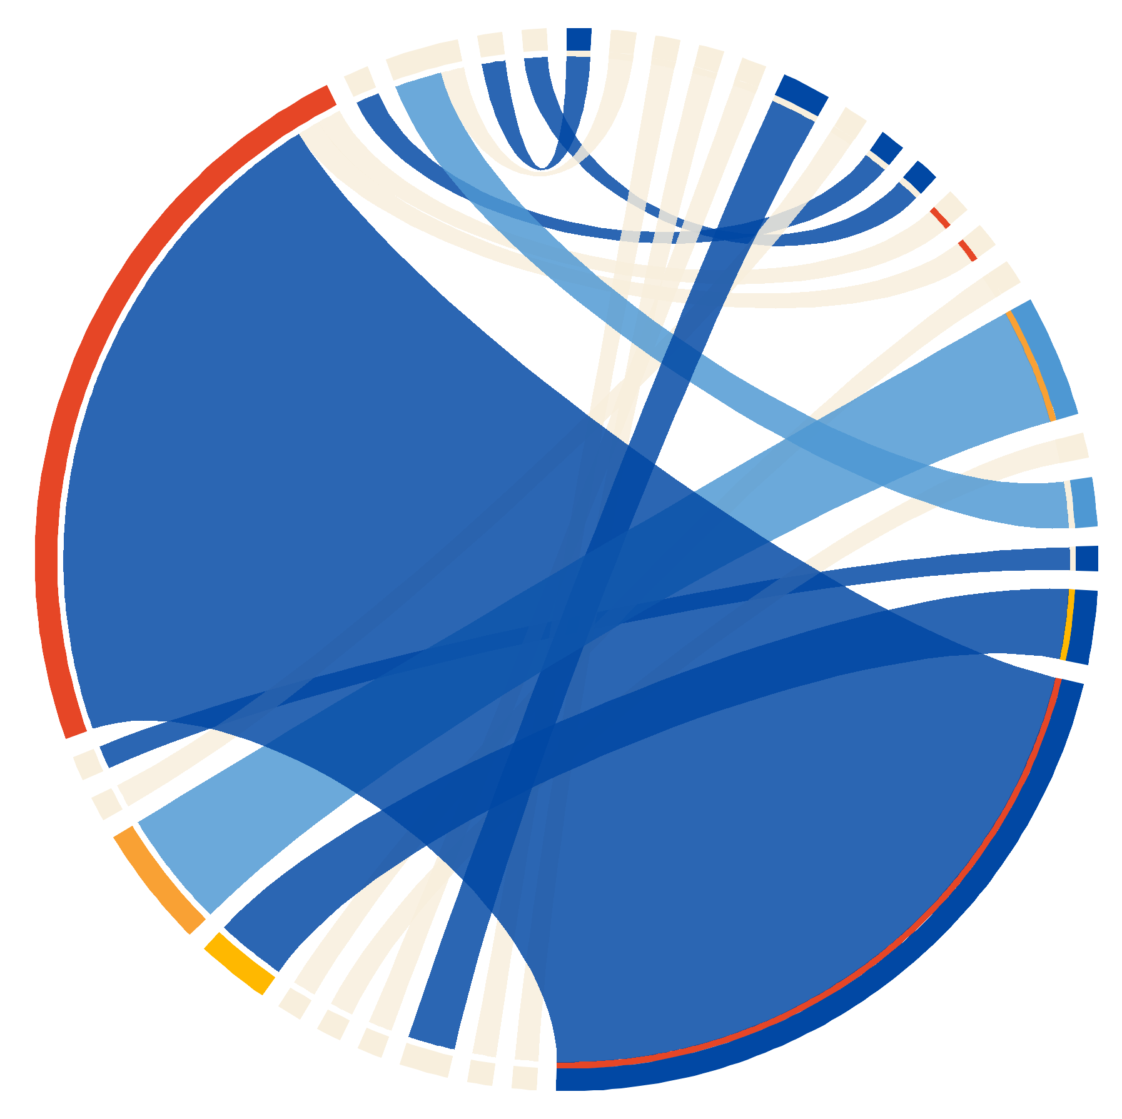






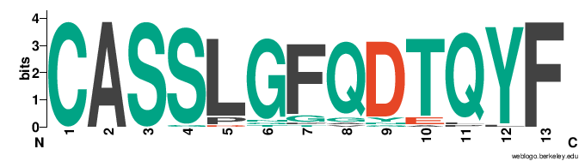
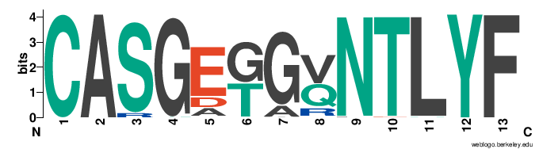
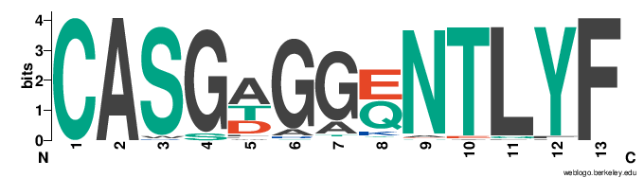
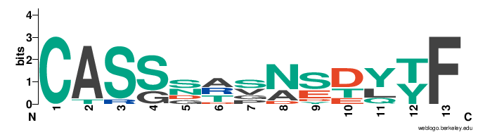
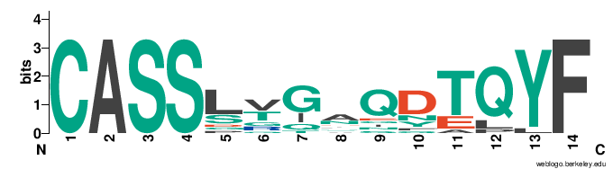



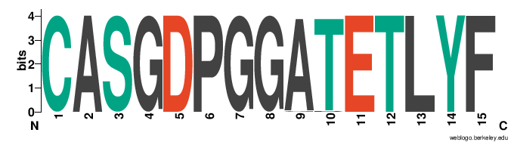

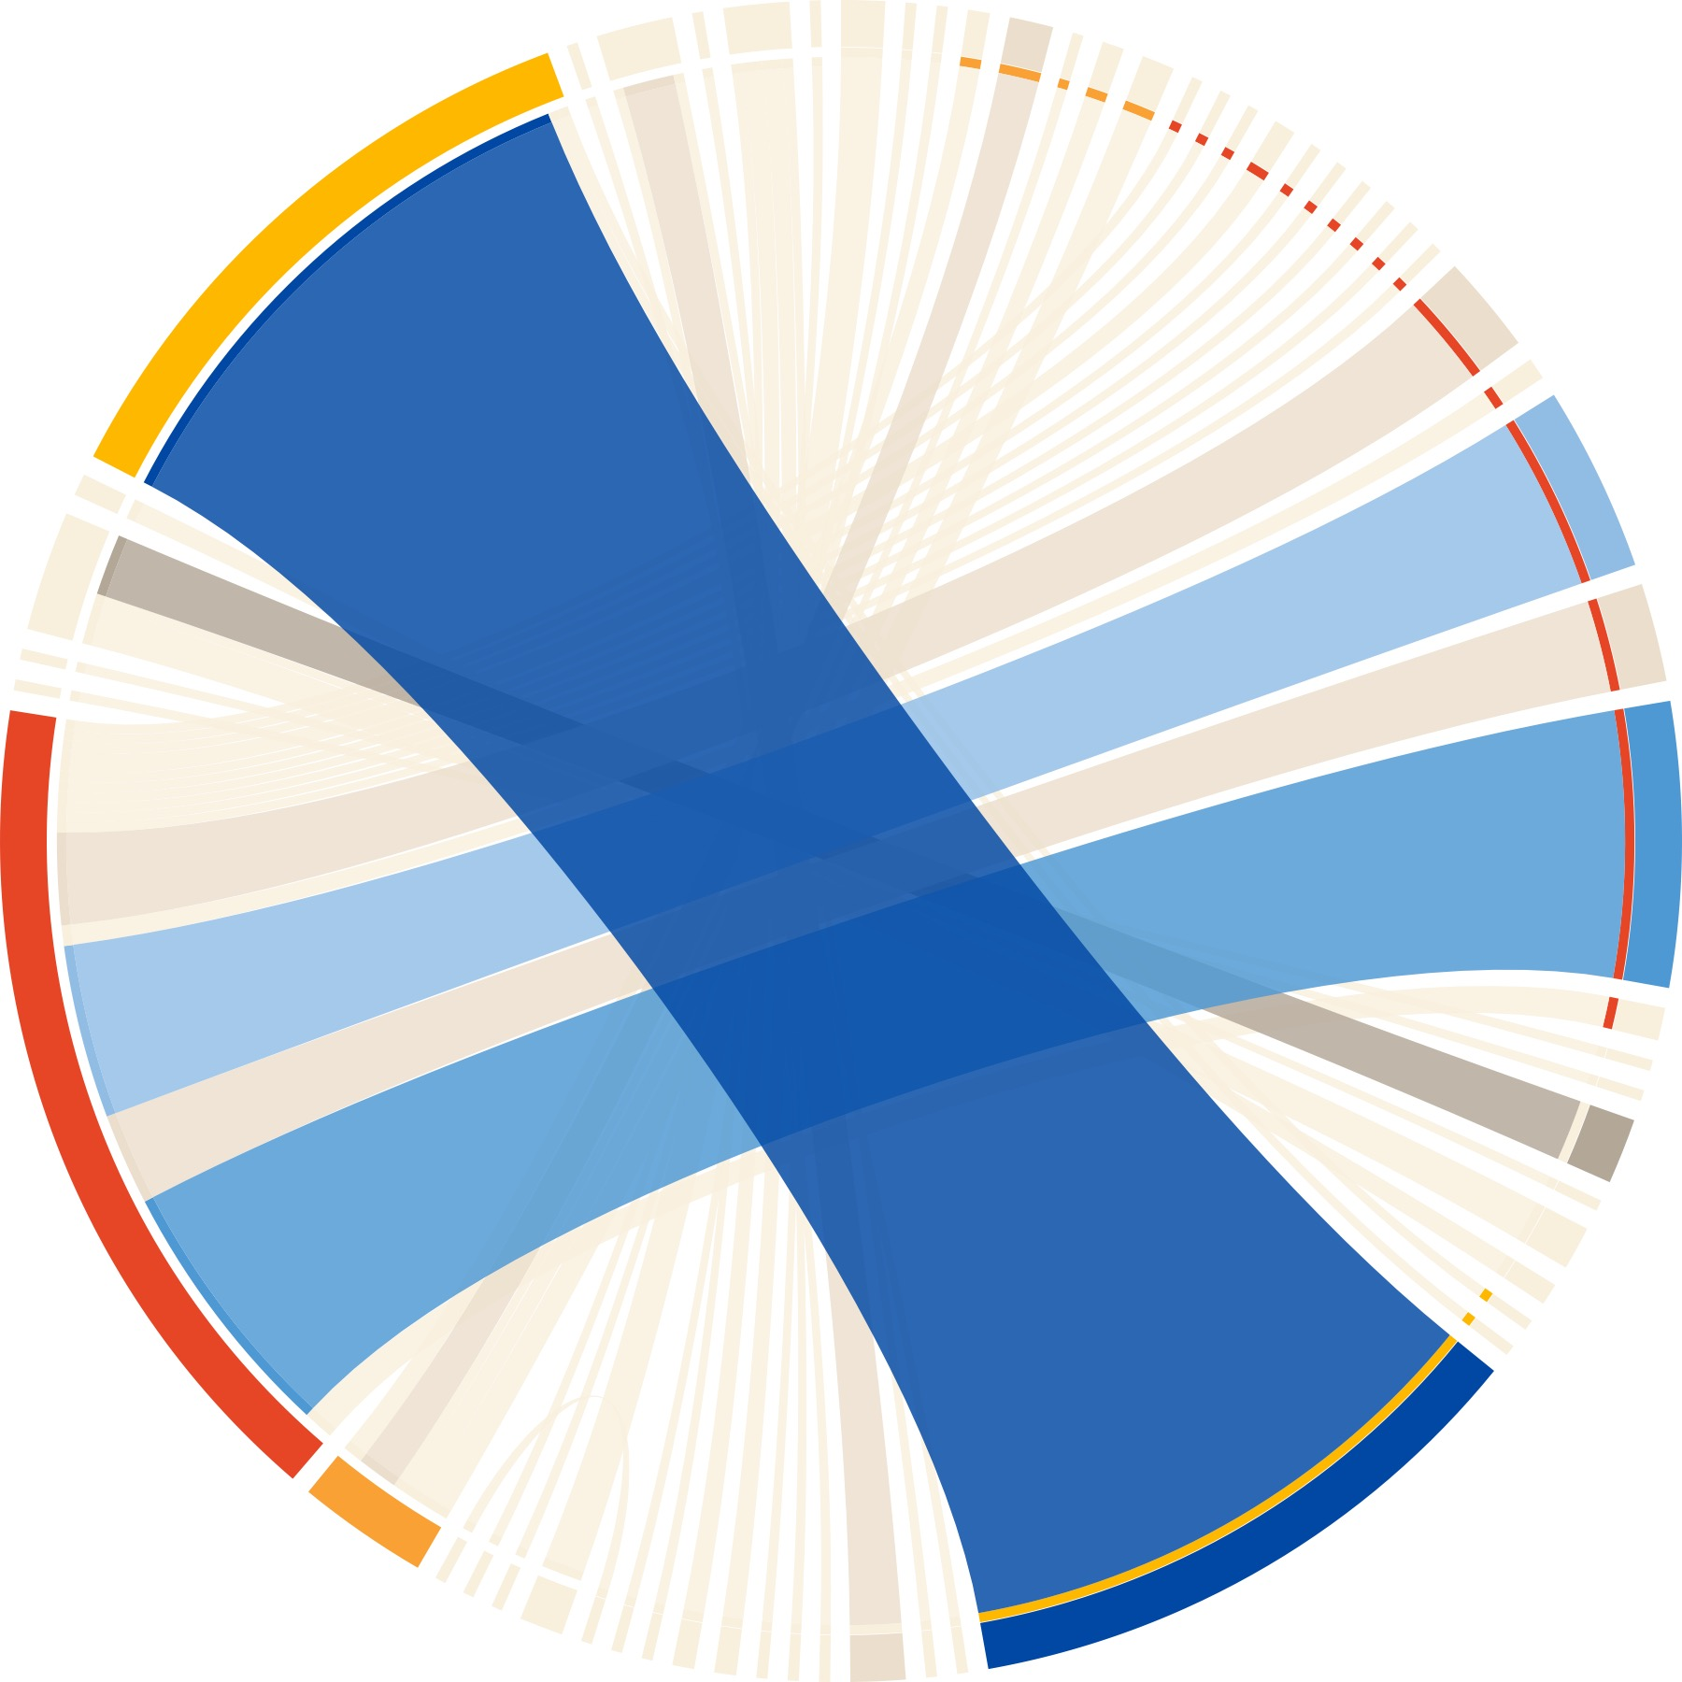
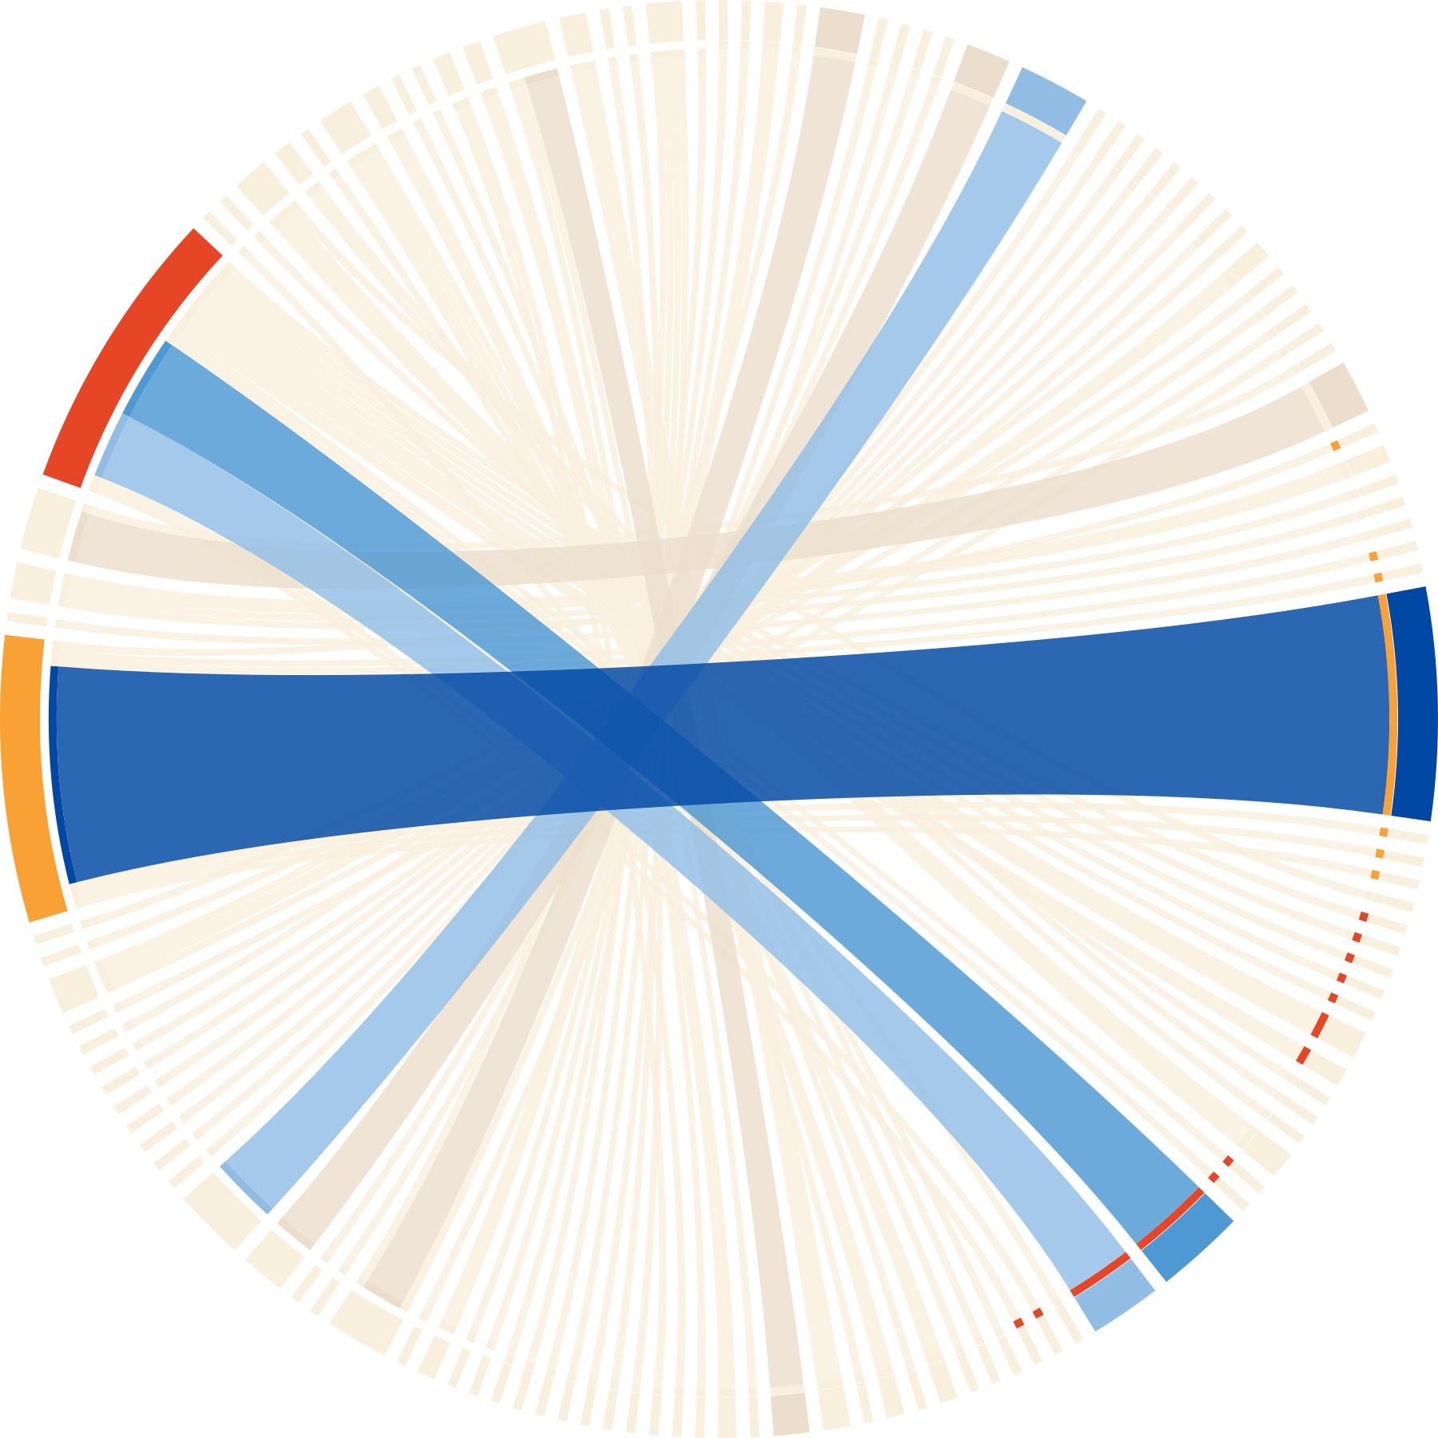
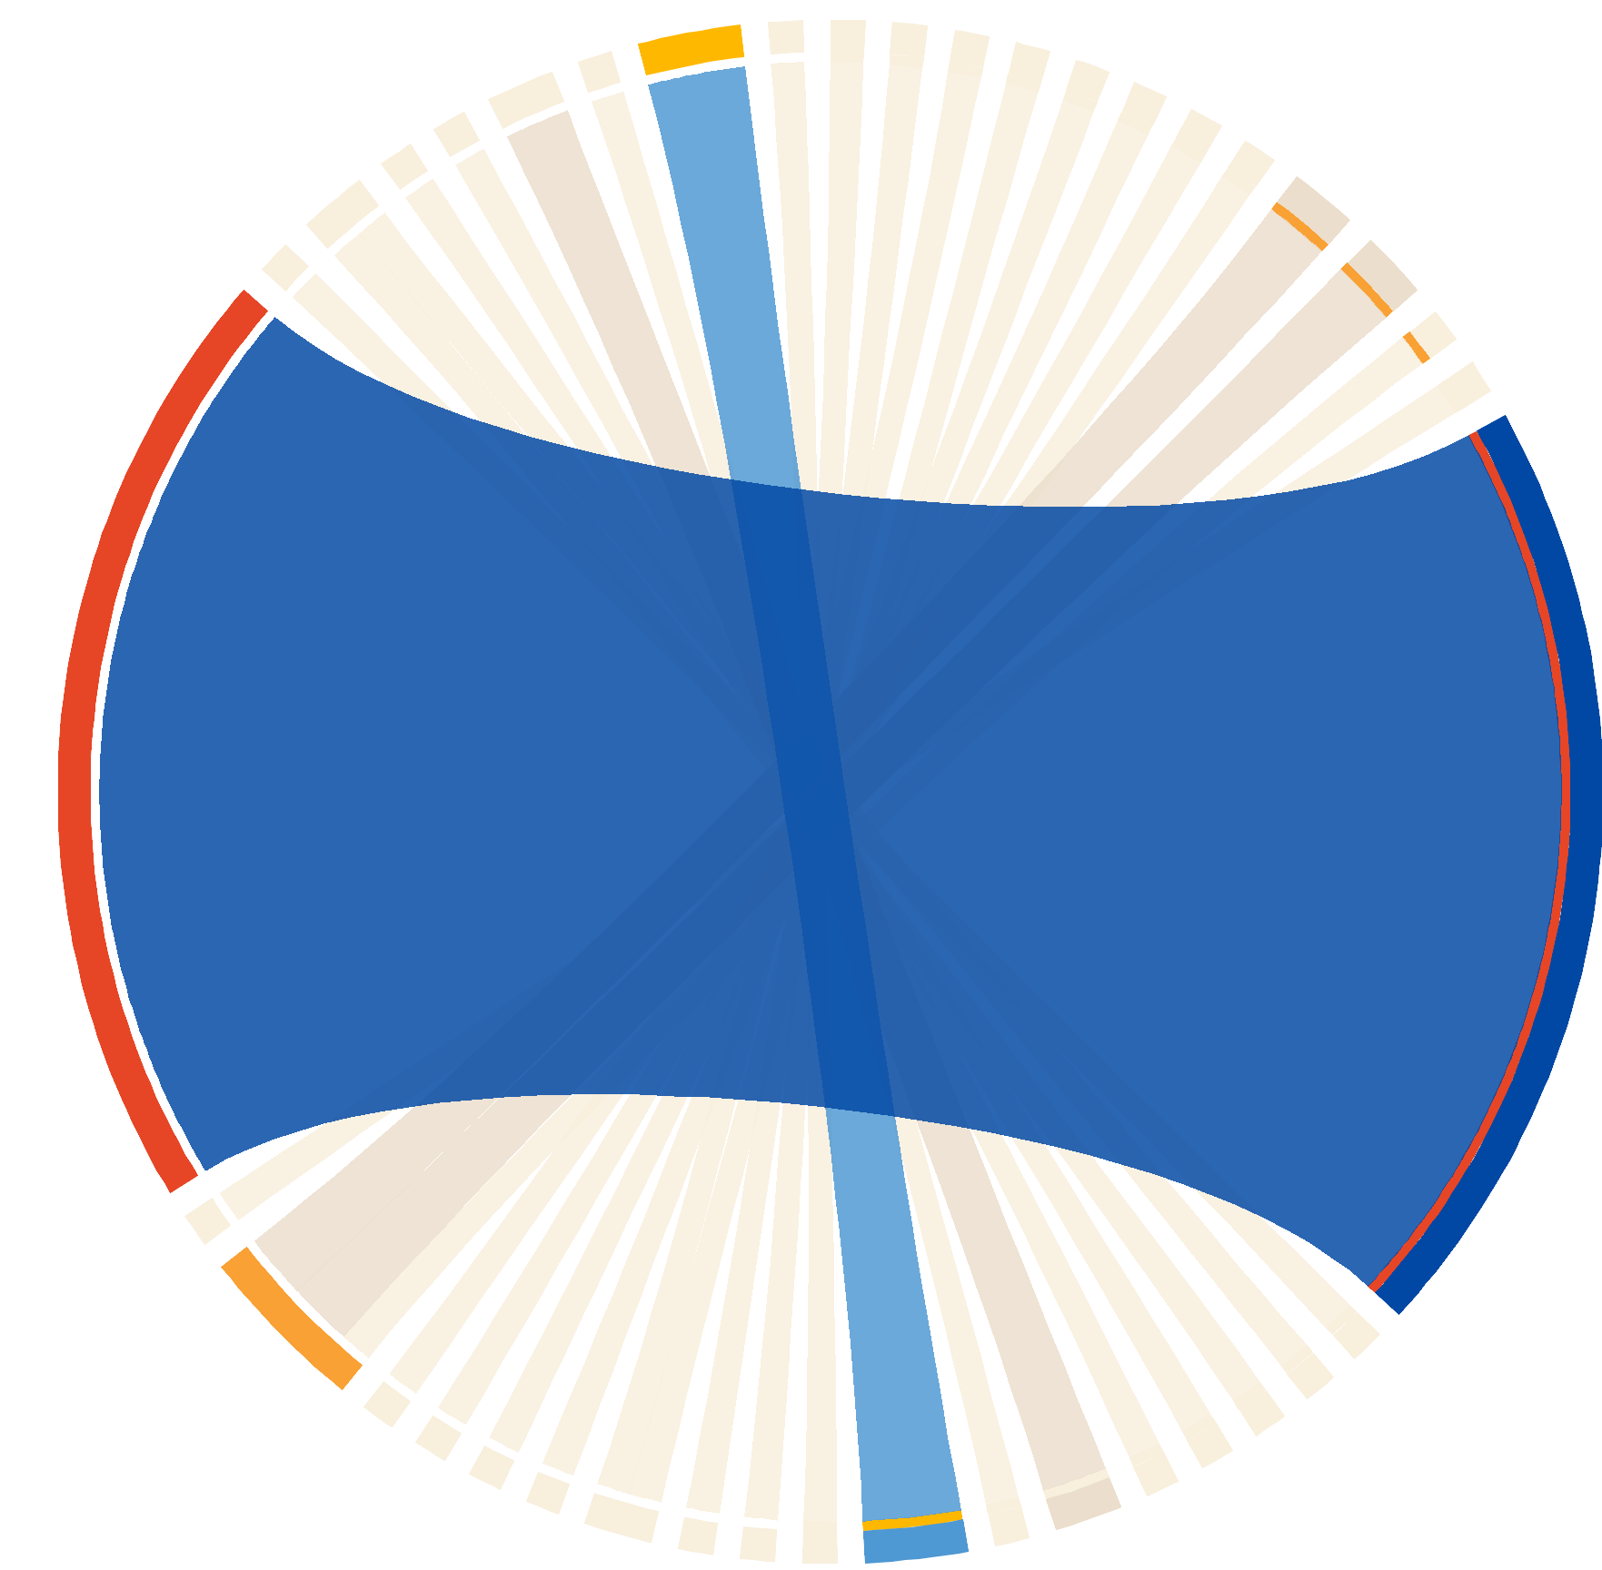

Determining the TCR repertoire in direct pMHC allorecognition by CD8+ T Cells
Moumita Paul-Heng¹, Eric T Son¹, Claerwen Jones², Mario Leong¹, Anthony W Purcell², Nicole L La Gruta², Nicole A Mifsud² and Alexandra Sharland¹
¹ Transplantation Immunobiology Research Group, Charles Perkins Centre, The University of Sydney
² Department of Biochemistry and Molecular Biology, Biomedicine Discovery Institute, Monash University
Background
Methods
In current clinical practice, there are no definitive means of identifying or characterising directly alloreactive T cells. Tools used to attenuate graft rejection (generalised immunosuppression) or GvHD (mature T cell depletion from the stem cell inoculum) remove protective T cells which combat infections or eliminate residual cancer cells, along with harmful T cells mediating immunopathology. Identifying allogeneic pMHC epitopes combined with the TCR repertoire of recipient alloreactive T-cells could facilitate immune monitoring and targeted immunotherapy. We identified over 40 H-2K^{b}-peptide epitopes that are directly recognised by CD8⁺ T cells from allogeneic B10.BR (H-2^{k}) or BALB/c (H-2^{d}) mice. Some “super-epitopes” are strongly recognised by T cells from both strains. We aimed to characterise the TCR repertoire responding to these epitopes.
B10.BR or BALB/c mice were primed with a K^{b}-bearing skin graft, and the alloresponse was boosted by inoculation with AAV-K^{b}. Single-cell index sorting was followed by multiplex nested PCR and sequencing of PCR products. The TCR sequences from dextramer-positive and PD-1⁻ bystander populations were compared.
Live cells
CD8⁺
PD-1⁺
Example flow cytometry graphs showing gating strategy to obtain PD-1⁻ and Dex+ cells for sequencing.
CD8
CD8⁺
PD-1⁺
Dex⁺
PD-1
Dextramer
CD90.2
PD-1⁻
CD44
CD8
V⍺ and Vβ chain diversity (single chain analysis)
Donut graphs representing alpha and beta chain repertoire of both PD-1⁻ bystander and super-epitope dextramer⁺ cells. Each segment is a TRAV or TRBV, and colours highlight conserved sequence identities across samples. There is a high diversity of both V⍺ and Vβ in the bystander cells compared to Dex+ populations, even across strains and pMHC targets. This diversity is indicated in the centre of the graphs, with sequenced cells at the bottom of the sets of graphs. Some alpha and beta chains are highlighted, showing a level of chain conservation seen against the same pMHC and across two strains of mice. For example, TRAV16D/DV11 makes up 25.8-50.3% of cells responding to Dex S, but only 9.25% of Dex V shown in orange ochre.
PD-1⁻ bystander cells
Super-epitope Dex⁺ cells
B10.BR 1 Dex S
B10.BR 2 Dex S
BALB/c Dex S
B10.BR Dex V
B10.BR 1 Dex S
B10.BR 2 Dex S
BALB/c Dex S
TRAV3
TRAV12D-2
48
47
49
V⍺
15
10
24
15
TRAV16D/DV11
TRBV13-1
TRBV13-3
17
16
18
Vβ
9
5
11
9
n=123
n=116
n=120
TRBV3
n=54
n=183
TRBV13-2
n=155
n=160
V⍺/Vβ pairing of Dex⁺ cells
CDR3a/b diversity of Dex⁺ cells
B10.BR 1 Dex S
B10.BR 2 Dex S
The CDR3 regions of the T cell receptor are highly critical to pMHC binding and allorecognition. Logo plots illustrate the diversity of amino acid residues of this region of the TCR chain according to size. Key identities are highlighted with abundance on top.
Conserved major CDR3a sequence across same strains against same dextramer with 44.8-51% abundance at 15aa
Conserved minor CDR3b between different strains but against same pMHC target at 11aa
Unique major CDR3b with high homogeneity at 15aa making up 30% abundance of specimen
Amino acid motifs are highly similar throughout against same dextramer, but different against Dex V
B10.BR Dex V
B10.BR 1 Dex S
B10.BR 2 Dex S
BALB/c Dex S
CDR3a
8
19
12aa
13aa
14 pairings from n=183
37 pairings from n=155
82
79
14aa
B10.BR Dex V
BALB/c Dex S
15aa
B10.BR Dex V
B10.BR 1 Dex S
B10.BR 2 Dex S
BALB/c Dex S
CDR3b
21
8
11aa
74
69
12aa
18 pairings from n=54
25 pairings from n=160
13aa
Circos plots illustrate V⍺ and Vβ pairing across the samples, revealing strong pairing preferences. The shades of blue represent the top 3 more abundant Vβ chains, and orange the top V⍺ chains.
14aa
55
15aa
TCR Clonality of Dex⁺ cells
Conclusions & Directions
B10.BR 1 Dex S
B10.BR 2 Dex S
A clonotype is defined as having the same TRAV-CDR3a-TRAJ TRBV-CDR3b-TRBJ. Conserved clonotypes exist across the current sample set as a minority.
For each pMHC epitope there are over-represented clones with strong V-segment pairing preferences. For peptide S, we found a number of closely related clones, differing only at junctions within the CDR3, while for peptide V, a single clone was dominant.
Completely different V-J segment usage between epitopes suggests that the peptide is the main target for TCR interaction – structural studies of selected receptor ligand pairs in future will be able to confirm or disprove this.
New technology will permit the determination of TCR repertoires for multiple pMHC epitopes in parallel, along with transcriptome sequencing and surface marker expression, greatly increasing throughput and yield of information. We plan to pilot this for 48 pMHC epitopes using Immudex dCODE dextramers and the BD Rhapsody Instrument.
SPECIMEN | TRAV | CDR3a | TRAJ | TRBV | CDR3b | TRBJ | Cells
B10BR 1 DexS | 14-1 | CAASAETGGYKVVF | 12 | 13-2 | CASGDPGGATETLYF | 2-3 | 54
B10BR 1 DexS | 16D_DV11 | CAMREGNSNNRIFF | 31 | 13-1 | CASRDINTEVFF | 1-1 | 6
B10BR 1 DexS | 16D_DV11 | CAMREANTGYQNFYF | 49 | 13-2 | CASGAGGRNTLYF | 2-4 | 9
B10BR 1 DexS | 16D_DV11 | CAMREGNTGYQNFYF | 49 | 13-2 | CASGDGAQNTLYF | 2-4 | 9
B10BR 1 DexS | 16D_DV11 | CAMREANTGYQNFYF | 49 | 13-2 | CASGEGGQNTLYF | 2-4 | 17
B10BR 1 DexS | 16D_DV11 | CAMREANTGYQNFYF | 49 | 13-2 | CASGETGVNTLYF | 2-4 | 26
B10BR 2 DexS | 16 | CAMREANTGYQNFYF | 49 | 13-2 | CASGAGGENTLYF | 2-4 | 26
B10BR 2 DexS | 16D_DV11 | CAMREANTGYQNFYF | 49 | 13-2 | CASGDGAQNTLYF | 2-4 | 8
B10BR 2 DexS | 16D_DV11 | CAMREANTGYQNFYF | 49 | 13-2 | CASGTGGQNTLYF | 2-4 | 10
B10BR 2 DexS | 6D-6 | CALSETSGSWQLIF | 22 | 13-1 | CASSDVGYEQYF | 2-7 | 8
B10BR DexV | 14-2 | CAASGGYNQGKLIF | 23 | 3 | CASSLGFQDTQYF | 2-5 | 28
B10BR DexV | 16D_DV11 | CAMREDQGGRALIF | 15 | 16 | CASSLVGAQDTQYF | 2-5 | 2
BalbC DexS | 12D-2 | CALDTNAYKVIF | 30 | 13-2 | CASGPGQYEQYF | 2-7 | 43
BalbC DexS | 16D_DV11 | CAMREDSGYNKLTF | 11 | 13-2 | CASGDLYEQYF | 2-7 | 28
BalbC DexS | 19 | CAAGVAGYQNFYF | 49 | 29 | CASSFRGGTGQLYF | 2-2 | 7
BalbC DexS | 3-4 | CAVSGGSNYKLTF | 53 | 13-3 | CASSLLGGGNAEQFF | 2-1 | 11
BalbC DexS | 3D-3 | CAVTMPNYNVLYF | 21 | 13-3 | CASRDINTEVFF | 1-1 | 5
44 clonotypes from n=183
78 clonotypes from n=155
B10.BR Dex V
BALB/c Dex S
Declarations
ETS, MP-H, PF, ND, AP, NM, AS are named inventors on a patent application related to this work. International (PCT) Patent Application No. PCT/AU2020/051221 – “Compositions for detecting alloreactive T cells”
22 clonotypes from n=54
45 clonotypes from n=160

